Slide 1
Battle Of Neighborhoods
Analysis of Indian Restaurants in Greater Toronto Area
-Hari Srinivasan

Slide 2
Introduction
Toronto is an international center of business, finance, arts, and culture, and is recognized as one of the most multicultural and cosmopolitan cities in the world
The cuisine of Toronto reflects Toronto's size and multicultural diversity.
Toronto is also home to many fine dining establishments and chain restaurants ranging from fast food to casual or upscale dining.
As a part of this project, we will explore the neighborhoods of Toronto, research and visualize the areas that has great Indian restaurants.

Slide 3
Background and Description of the Problem
For somebody trying to immigrate to Canada from India, there are multiple things to consider before the migration.
Cost of living, housing, demographic and proximity to Indian restaurants and grocery stores
Challenge is to identify the best among those restaurants and the areas where they are concentrated

Slide 4
Project Goals -Answer to questions
Which is the best place to stay if I prefer Indian Cuisine?
What is the best location in Toronto for Indian Cuisine?
Which areas lack Indian Restaurants and have potential for a new Indian Restaurant?

Slide 5
Project Strategy
Data
Methodology
Steps
Data
Toronto data that contains list Boroughs, Neighborhoods, Postal Code including Latitude and Longitude
Data source : 'https://en.wikipedia.org/wiki/List_of_postal_codes_of_Canada:_M'
Indian restaurants in each neighborhood of Toronto.
Data source : Fousquare API
Methodology
Use the wikipedia data combined with Foursquare to get Borough and Neighborhood with the most number of Indian restaurants.
Identify the top restaurant for an area based on the results from 1 using 'ratings', 'likes' and 'tips'.
Utilize Bar chart visualization to get insights into Indian restaurant details.
Summarize the results and draw conclusion

Slide 6
Steps
Import necessary libraries for data and feature engineering
Collect the Toronto data from https://en.wikipedia.org/wiki/List_of_postal_codes_of_Canada:_M
Utilize Foursquare API to get the venue details and Indian restaurants
Get ratings and tips for the restaurants from Foursquare API
Results, Conclusion and Discussion *** Visualize data as needed for analysis

Slide 7
Data Visualization and Analysis

Slide 8
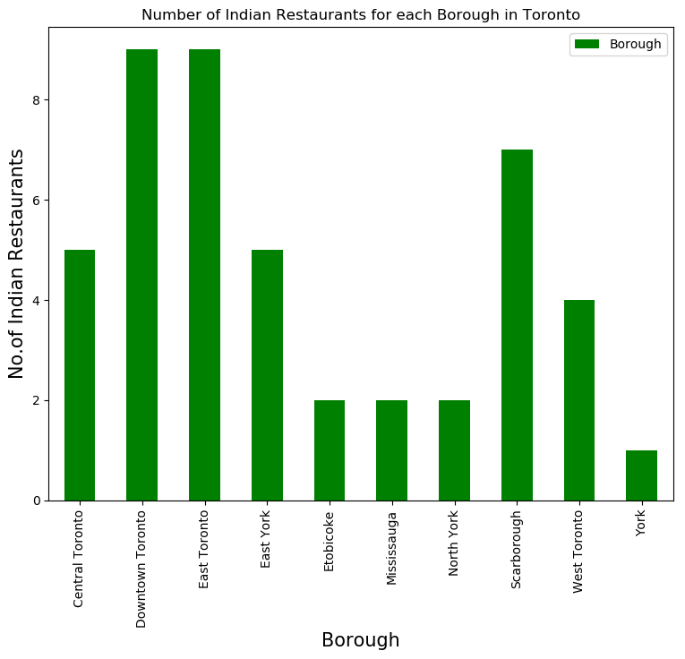
Toronto Indian Restaurants By Borough
Downtown and East Toronto has more than 9 Indian restaurants
York has the least number of Indian Restaurants
Toronto (Downtown, East, West and Central) contributes to the majority of Indian cuisines

Slide 9
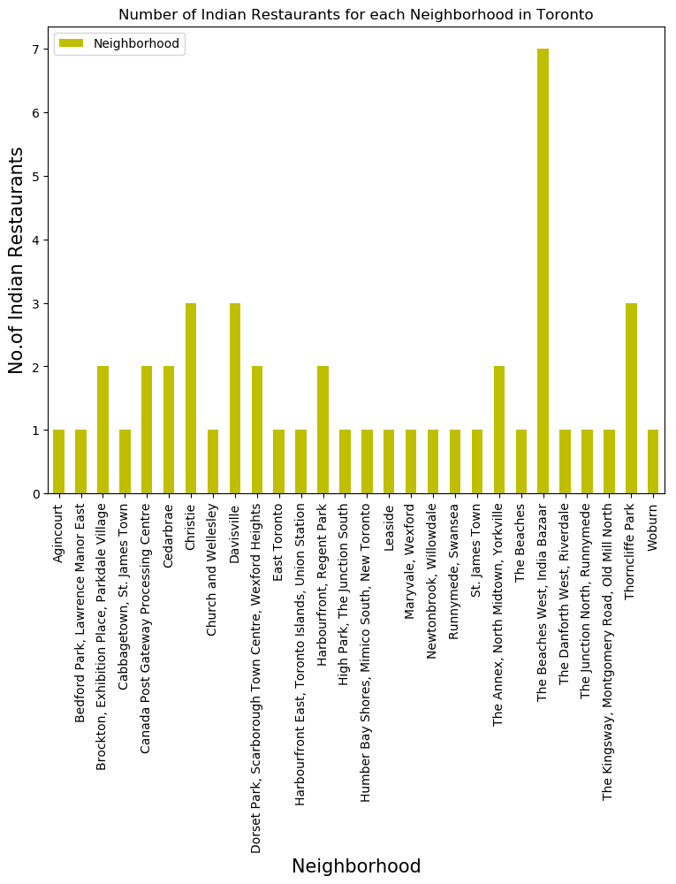
Toronto Indian Restaurants By Neighborhood
The Beaches West, India Bazaar Neighborhood has the most Indian restaurants
Christie, Davisville and Thorncliffe park are the second most popular neighborhoods for Indian cusine

Slide 10
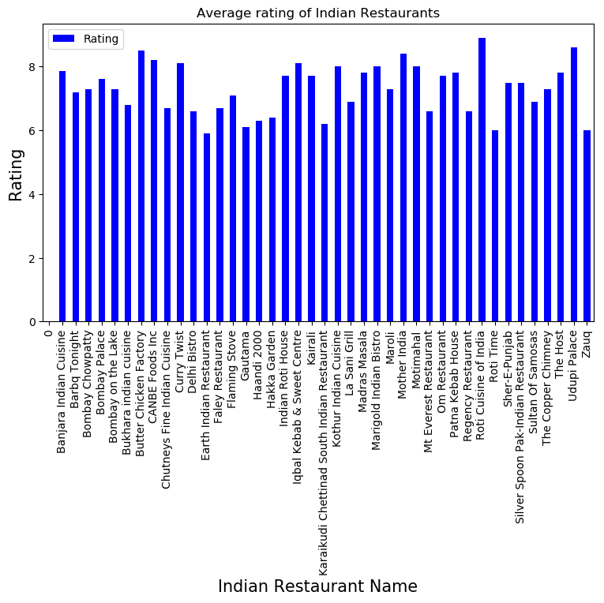
Indian Restaurants by Rating
Roti Indian Cuisine is the top rated Indian Restaurant
Banjara Indian Cuisine and Udupi Palace are also rated high

Slide 11
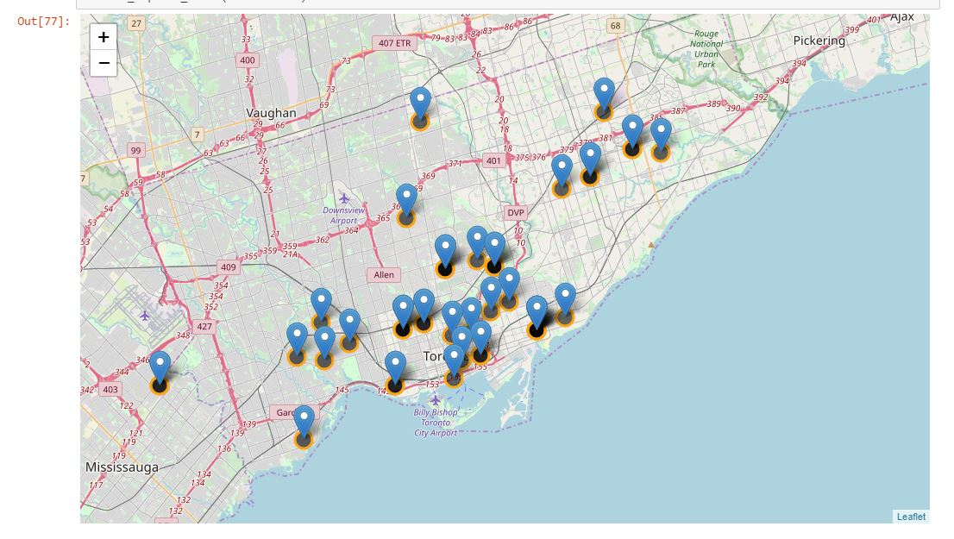
Indian Restaurants in Toronto - Map

Slide 12
Results, Conclusion and Discussion
The Beaches West, India Bazaar neighborhood in East Toronto Borough is the best place for Indian restaurants
Christie, Davisville and Thorncliffe park are the next best neighborhoods for Indian cuisine
Boroughs- Downtown Toronto, East Toronto and Scarborough has the most number of Indian restaurants in Greater Toronto Area
Banjara Indian Cuisine is rated as the best indian restaurant with cheap pricing
Roti Indian cuisine is equally good but it is a little expensive

Slide 13
Answer to Questions
Which is the best place to stay if I prefer Indian Cuisine? The Beaches West, Indian Bazaar neighborhood
What is the best location in Toronto for Indian Cuisine? Downtown and East Toronto
Which areas lack Indian Restaurants and have potential for a new Indian Restaurant? Etobioke, North York and York seem to have potential for some Indian cuisine. But the demographic and 'likes' need to be researched for market analysis.

Slide 14
Limitations
Data accuracy is limited to Foursquare API
Ratings are solely based on the responses section of Foursquare API
New restaurants that were not added to the API is not reported
Folium map is not rendered in the final report and an image of the map is uploaded to GitHub.

